Slide 1
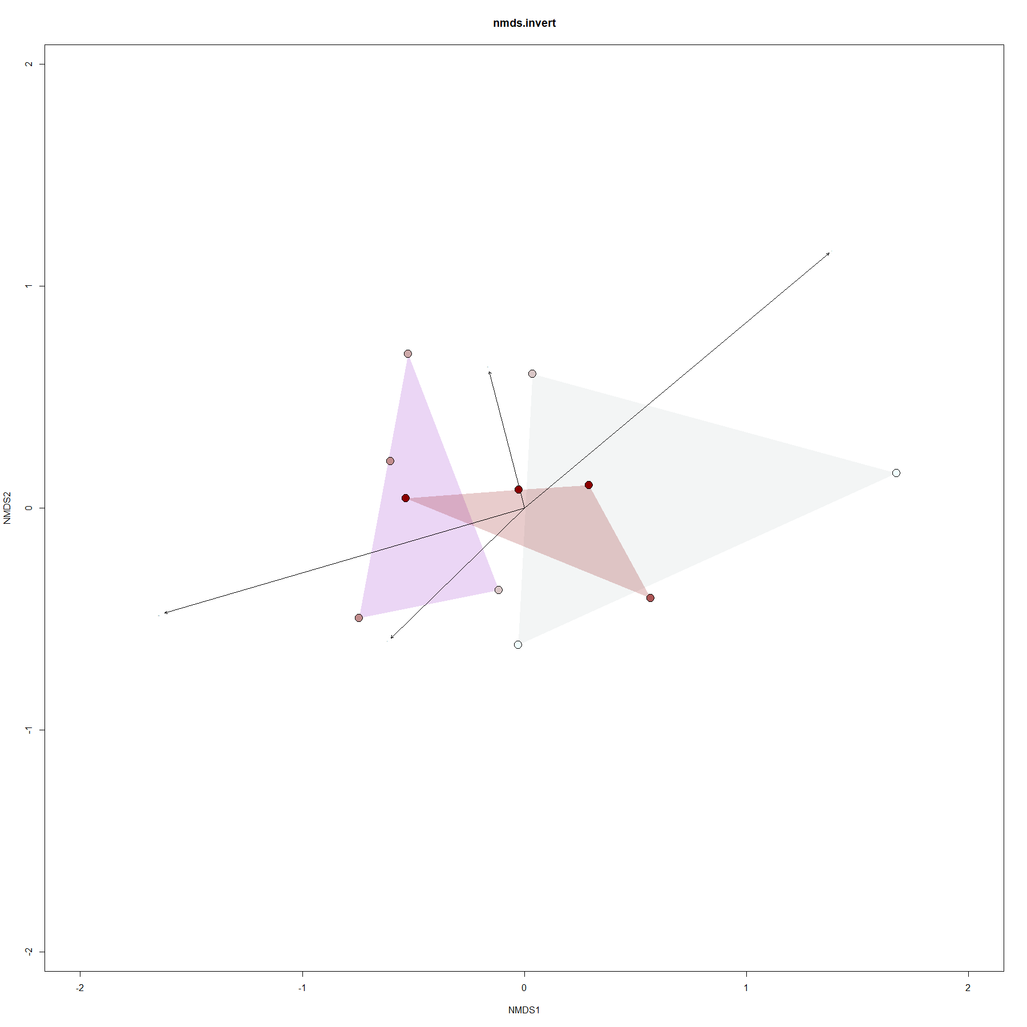
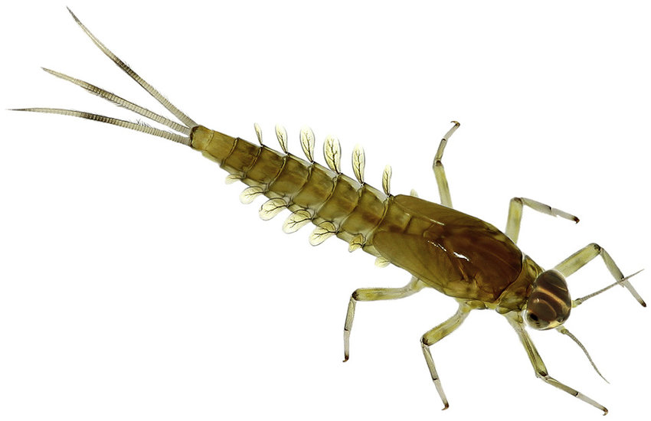
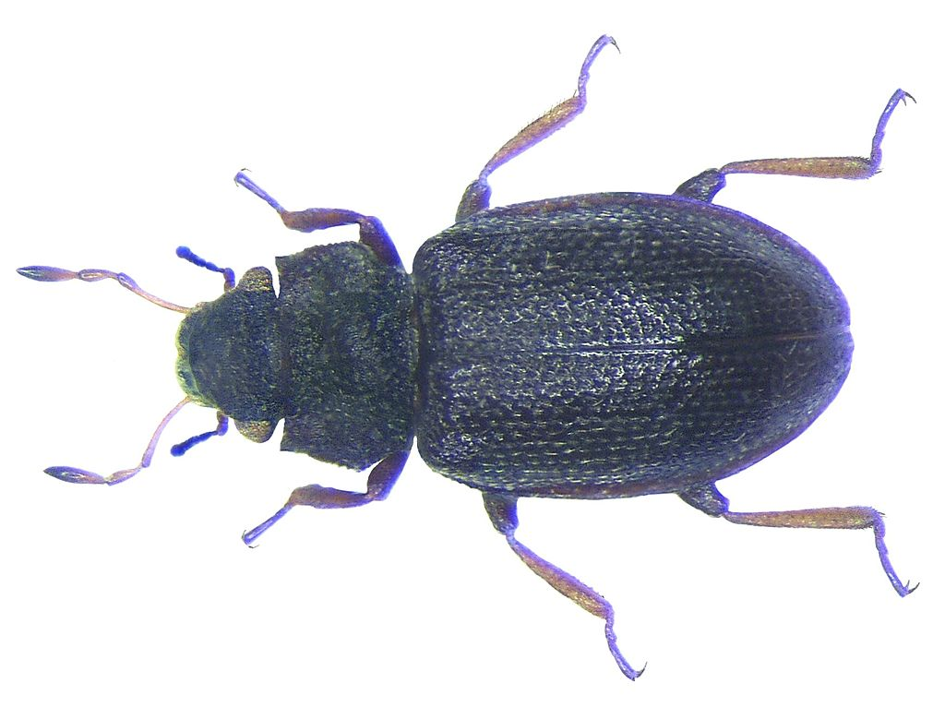
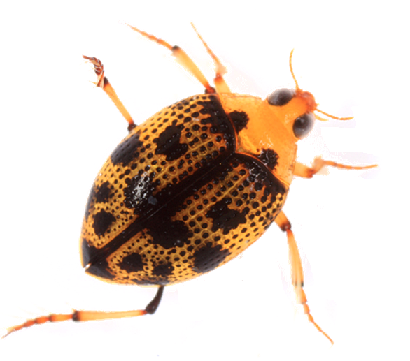
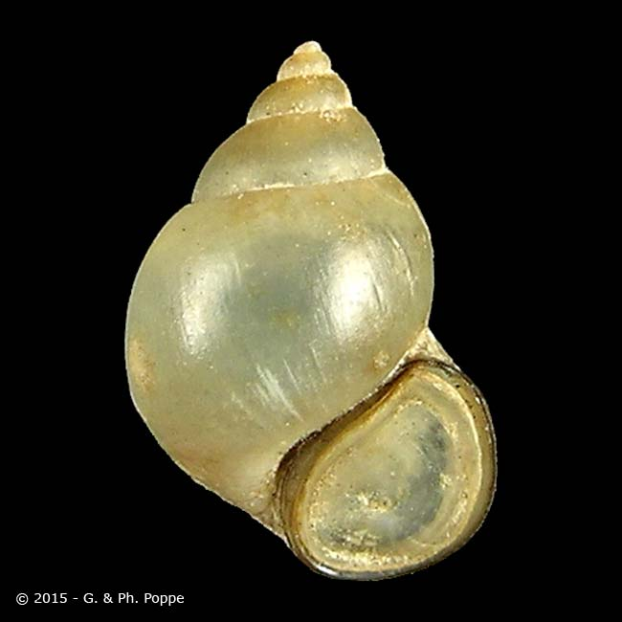
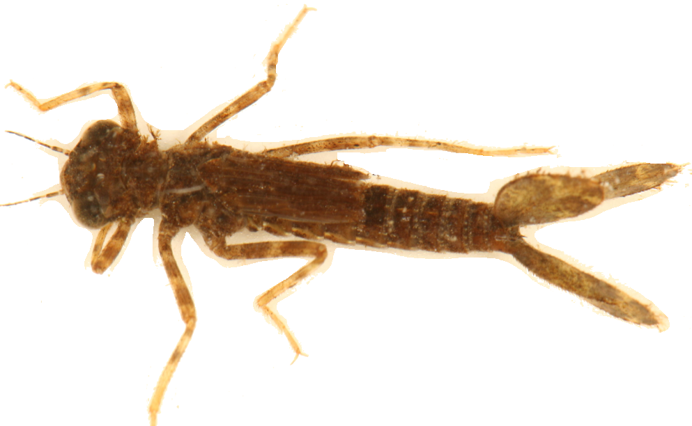
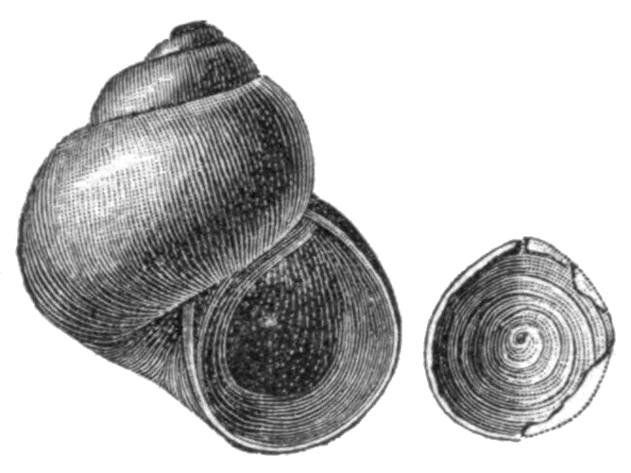
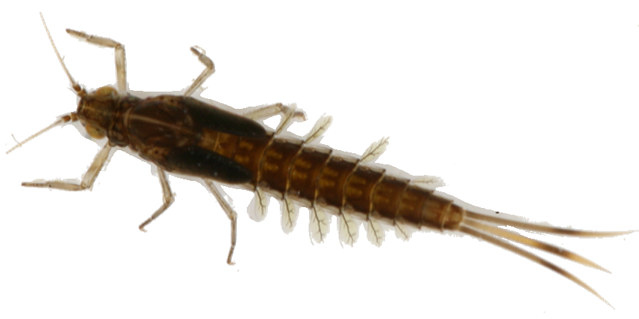
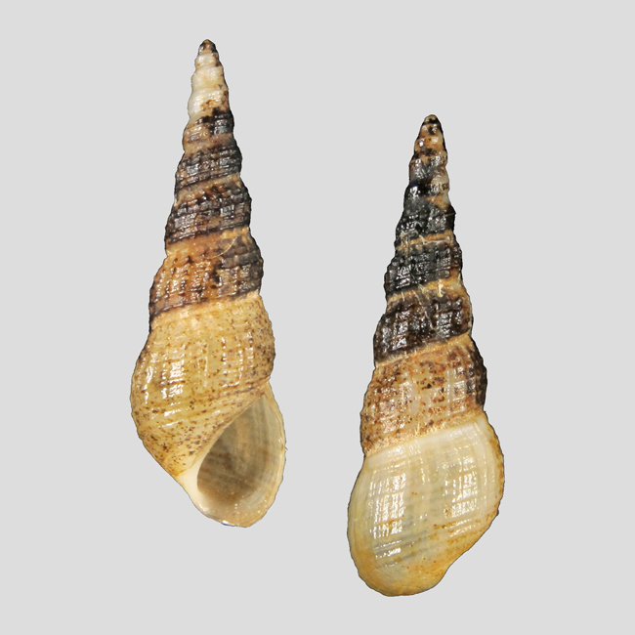
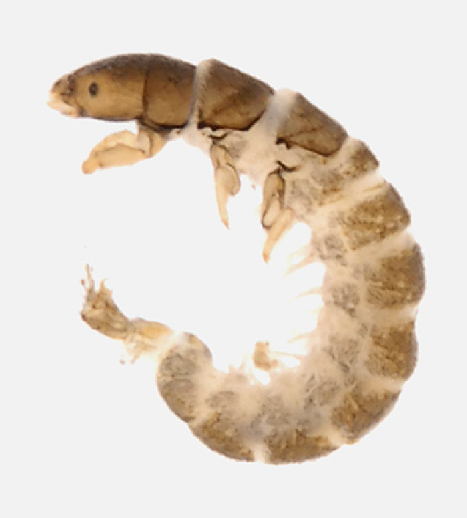
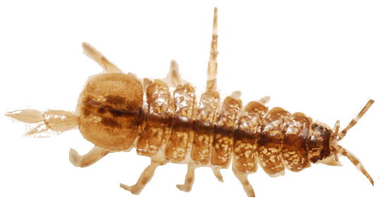
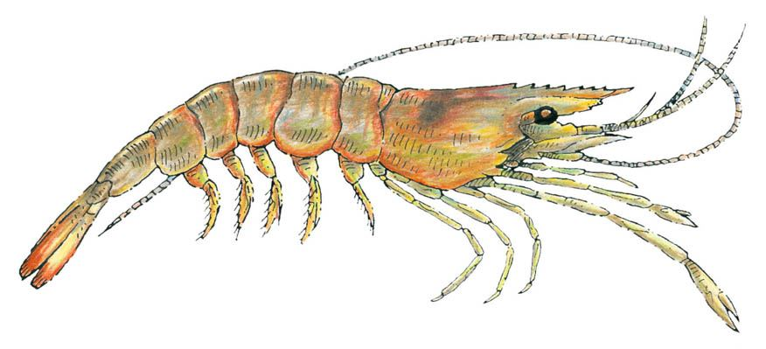
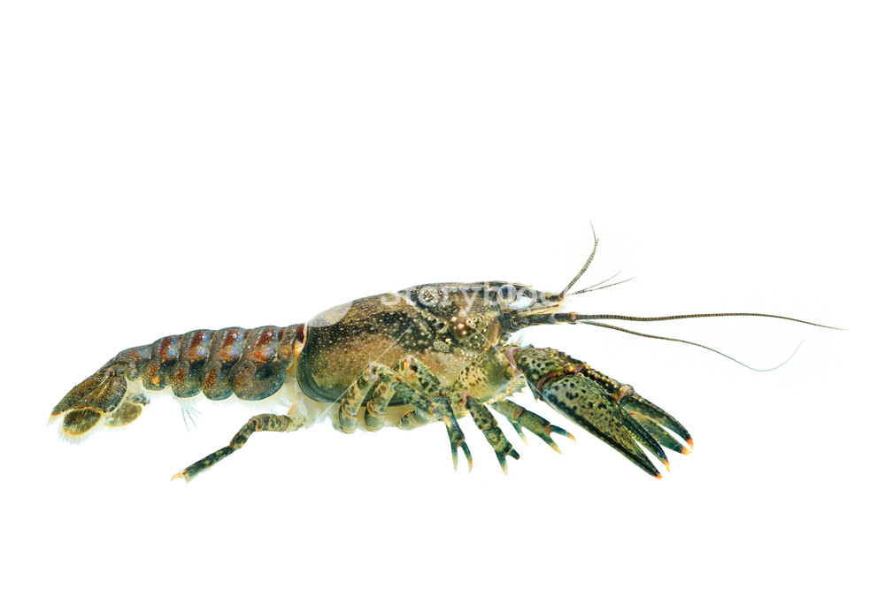
Fallceon
Conductivity
1
RiparianFarm
Hydraena
Peltodytes
Chromagrion
Bythinia
Mesic
Semi-Arid
Amnicola
0
NMDS2
Pseudocloeon
Sub-Humid
Phosphate
Melanoides
Precipitation
-1
Smicridea
Orconectes
Palaemonetes
Caecidotea
-1.0
0
1
2
NMDS1
NMDS ordination of Benthic Invertebrate communities in eleven coastal prairie streams in South Texas.
Sites are grouped according to Annual Precipitation [Semi-Arid < 80 cm/yr, Mesic <100 cm/yr, Sub-Humid <125 cm/yr].
Distances between sites are proportional to compositional differences in community.
The explanatory power of environmental factors is indicated by the length and direction of the arrows Farm represents the proportion of farmed land within 100m riparian zone. Disturbance represents the Hydrologic Disturbance Index.
Labeled Illustrations indicate the location of various genuses within the ordination space.

Slide 2
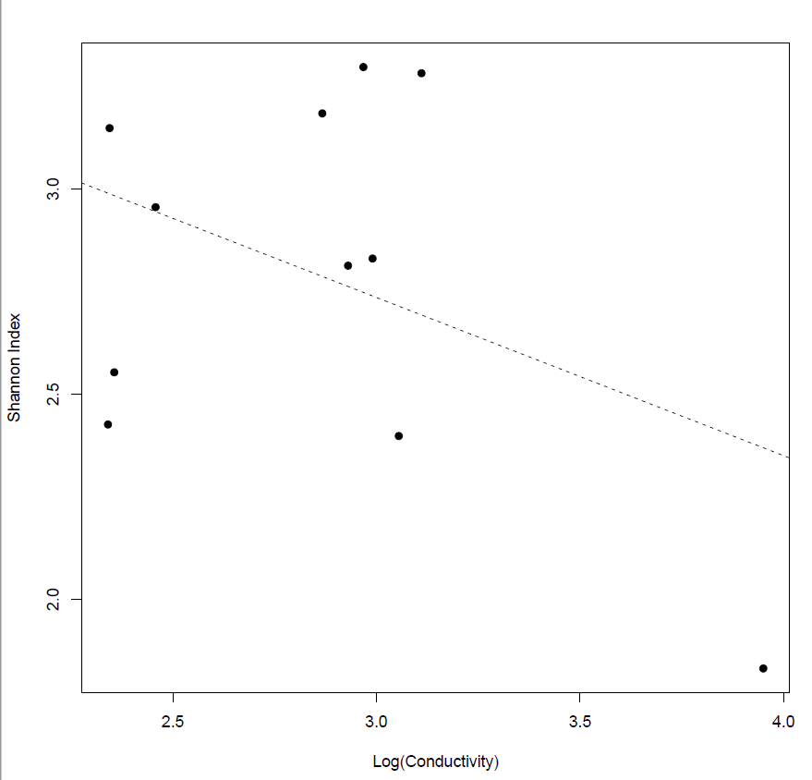
3.0
Shannon Index
2.5
2.0
S = -0.3857(C) + 3.8930
R² = 0.1629
p = 0.2183
2.5
3.0
3.5
4.0
Log(Conductivity)

Slide 3
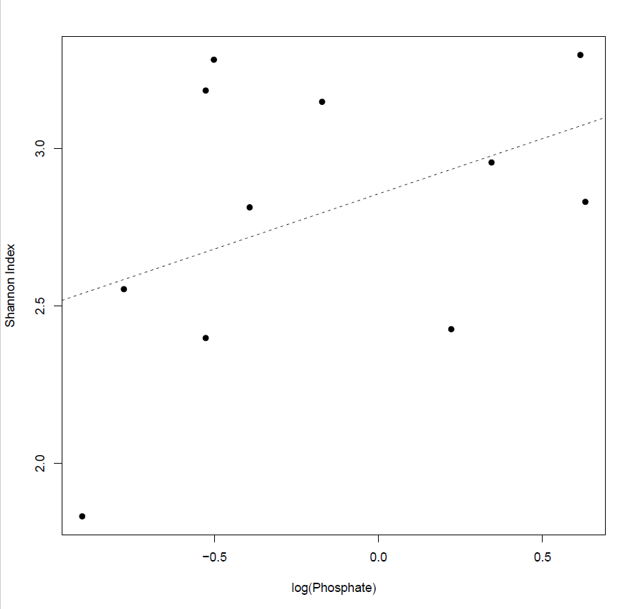
3.0
Shannon Index
2.5
S = 0.3509(P) + 2.8562
R² = 0.1776
p = 0.1968
2.0
-0.5
-0.0
0.5
Log(Phosphate)

Slide 4
Amnicola sp.
Credit: Richard Ellsworth Call
Bythinia sp.
Credit: Guido T. Poppe & Philippe Poppe
Melanoides sp.
Credit: Guido T. Poppe & Philippe Poppe

Slide 5
Baetis sp.
Credit: Cyril Bennett
Pseudocloeon sp.
Credit: D.S. Chandler
Palaemonetes sp.
Credit: Calvert Marine Museum
Orconectes sp.
Credit: storyblocks.com
Caecitodea sp.
Credit: Javier Alcocer

Slide 6
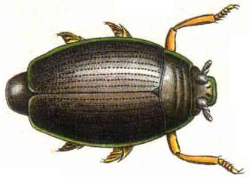
Peltodytes sp.
Credit: Tom Murray
Gyrinus sp.
Credit: 1909 illustration
Hydraenidae
Credit: Udo Schmidt

Slide 7
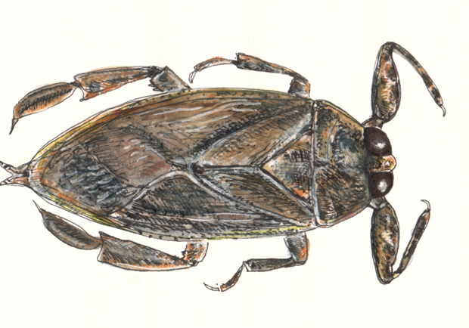
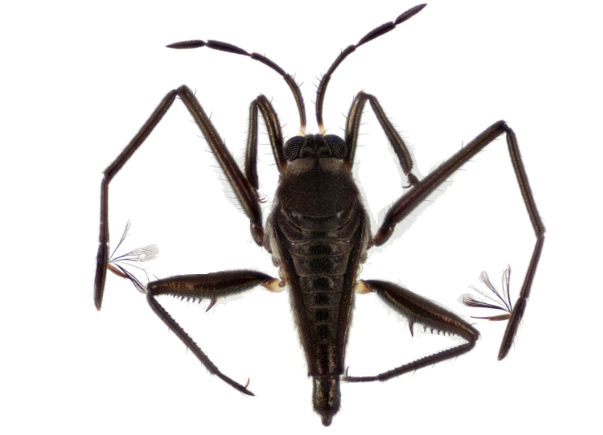
Belostomatidae
Credit: Halvard
Rhagovelia sp.
Credit: Dr. E. Santos
Smicridea sp.
Credit: M. Zumbado
Cheumatopsyche sp.
Credit: 2014 BOLD Systems

Slide 8
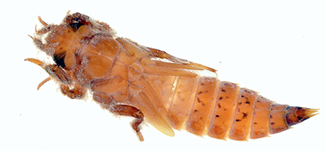
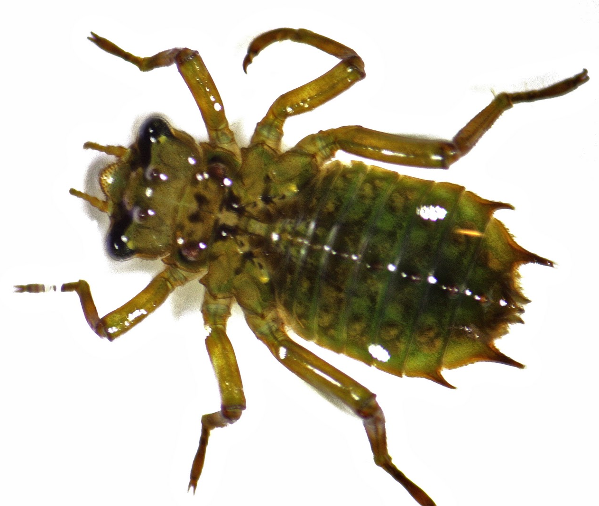
Gomphidae
Credit: Ethan Bright
Corduliidae
Credit: Bob
Chromagrion sp.
Credit: Tom Murray

